Slide 1
News Headlines Sentiments’ Impacts on Stock Returns
By Yifan Gao, Jungmin Kim, Mike Wu

Slide 2
Business Context & Agenda I
Goal: Find the characteristics of securities derived from social media factors have significant power in explaining the time-series variation in daily returns. The Social Media Factor, the “sixth” factor, is distinct from the traditional five factors authored by Fama and French.
Urgency: Fama-French Model (5 factor) is a financial model that quantify risk and translate that risk into estimates of expected return on equity. It can usually explain 71% - 94% of the cross-section variance of expected returns for the size, value, profitability and investment portfolios. Therefore there are still room for other factors to captured into the model.

Slide 3
Business Context & Agenda II
Goal: Try to predict excess return using sentiment scores and Fama-French factors, as well as understand what features explain the variance the most
Business Context: Besides linear regression, investors/institutions would like to learn what other models can predict excess return better than linear regression. A time series model is a bad idea because according to efficient market hypothesis, return cannot be predicted using past information so traditional time series model usually doesn’t work. Also, a return series after transformation is usually a white noise, which is serially uncorrelated and unpredictable.
Seeking Pattern & Insight: Whether R2 score can be improved significantly with other regression models

Slide 4
Business Context & Agenda III
Goal: Explore how our extracted sentimental scores are related or affecting the fluctuations of stock returns
Business Context: Investors usually experience some kind a of noticeable stocks fluctuations right before or after a big news reported in the publics.
Seeking Pattern & Insight: How our 0-3 days lagging sentimental scores are anyway related to the fluctuated prices

Slide 5
Data Sources & Engineering
Kaggle (https://www.kaggle.com/priyapitre/ff-project)
Date: <Date>, e.g 2020-06-05 10:30:00-04:00
News Titles: <Text>, e.g Wells Fargo Maintains Overweight on Agilent Technologies, Raises Price Target to $95
Tickers, <Text>, e.g "AAPL","IBM","NFLX","AMZN"
Yahoo Finance API Package
Date, DailyReturns <Numeric>
Fama_Factor (https://mba.tuck.dartmouth.edu/pages/faculty/ken.french/data_library.html)
Mkt-RF , SMB , HML , RMW , CMA , RF <Numeric>
Data Cleaning & Engineering
Scraping, remove NA, duplicates, merging data by dates & ticker, Standardizations

Slide 6
Work Flows
Implement LSTM and FINBERT NLP models to conduct Financial News Headlines Sentiments Analysis and create the sentiment score for each stocks
and normalize it to be our final sentiment score (20 days look back periods)
Explore and Test Statistical Significance of the Impact from Financial News Headlines on Stocks Fluctuations by adding final sentiments score as social media factor (6th) into Fama-French Model
Explore interesting patterns or insights between news headlines sentiment with stocks’ returns by implementing clustering techniques
Build Supervised Learning Models with Fama-French factors, Sentiments Factors, to Predict excess return and evaluate their performing results

Slide 7
Part I. NLP Sentiments

Slide 8
Extract Sentiments Score from News Headliners Texts
Use tokenizer to vectorize and convert text into sequences so the network can deal with it as input
Implement LSTM and FinBERT models to conduct sentimental analysis
Calculate sentiment score by subtracting negative sentiment score from positive sentiment score
Calculate normalized final sentiment score by taking (sentiment score) minus (20 days moving average on sentiment scores) divided by (standard deviation of 20 days moving average on sentiment scores)
S(t) = Positive(t) - Negative(t)
Final_score(t)= (S(t) - MA(S(t)))/sd(MA) (20 days windows)
Extract selected stocks daily returns from Yahoo Finance API and combined with our calculated final sentiment scores

Slide 9
Sentimental Analysis with LSTM Model - Long/Short Term Memory
Implement Sentiment analysis through Recurrent neural Networks, which are then run through LSTM.
Long short-term memory is an artificial recurrent neural network architecture used in the field of deep learning.Unlike standard feedforward neural networks, LSTM has feedback connections. It never keeps the entire data like standard recurrent neural network, lstm keeps short-term memory of data.
Long short-term memory (LSTM) is a type of recurrent neural network that allows long-term dependencies in a sequence to persist in the network by using "forget" and "update" gates.
LSTMs are explicitly designed to avoid the long-term dependency problem. Remembering information for long periods of time is practically their default behavior, not something they struggle to learn
The LSTM pre-training model
*** LSTM is an unsupervised learning method, although technically, they are trained using supervised learning methods, referred to as self-supervised. They are typically trained as part of a broader model that attempts to recreate the input

Slide 10
Sentimental Analysis FINBERT Model
FinBERT is a Transformer model developed as part of a master thesis by Dogu Araci and trained fully on financial news articles. FinBERT is a language model based on the BERT (Bidirectional Encoder Representations) model developed by Google in 2018
FinBERT has two important differences from what came before: 1) It defines the task of language modeling as predicting randomly masked tokens in a sequence rather than the next token, in addition to a task of classifying two sentences as following each other or not. 2) It is a very big network trained on an unprecedentedly large corpus.
FinBERT is in essence a language model that consists of a set of Transformer encoders stacked on top of each other. Instead of predicting the next word given previous ones, FinBERT "masks" a randomly selected 15% of all tokens. A second task FinBERT is trained on is "next sentence prediction". Given two sentences, the model predicts whether or not these two actually follow each other.
Advantage: Because FinBERT is trained on financial news, it is a good model to tackle Natural Language Processing (NLP) tasks in the financial domain.
In here, we used a pre-trained FinBert Model to Implement our sentimental analysis
FinBERT pre-trains a language model as an unsupervised task.

Slide 11
Part II. Fama-French Model

Slide 12
What is Fama-French Model
The Fama French 5-factor model is an asset pricing model that expands on the capital asset pricing model by adding size risk, value risk, profitability risk, investment risk factors to the market risk factors.
The model was developed by Nobel laureates Eugene Fama and his colleague Kenneth French in the 1990s.
The model is essentially the result of an econometric regression of historical stock prices.

Slide 13
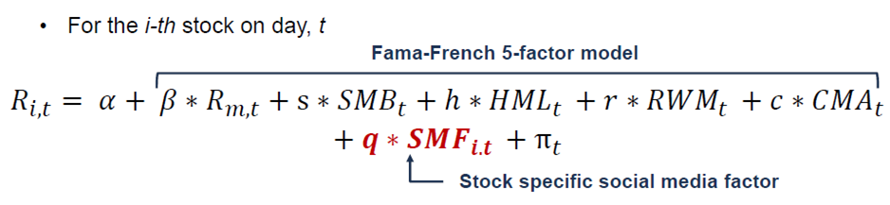
Fama-French 5 Factor Model Implementation
Factors are
Market excess return
Excess return on small minus big market capitalization firms
Excess return on high minus low book-to-market value firms
Excess return on robust minus week gross profit firms
Excess return on conservative minus aggressive investment firms

Slide 14
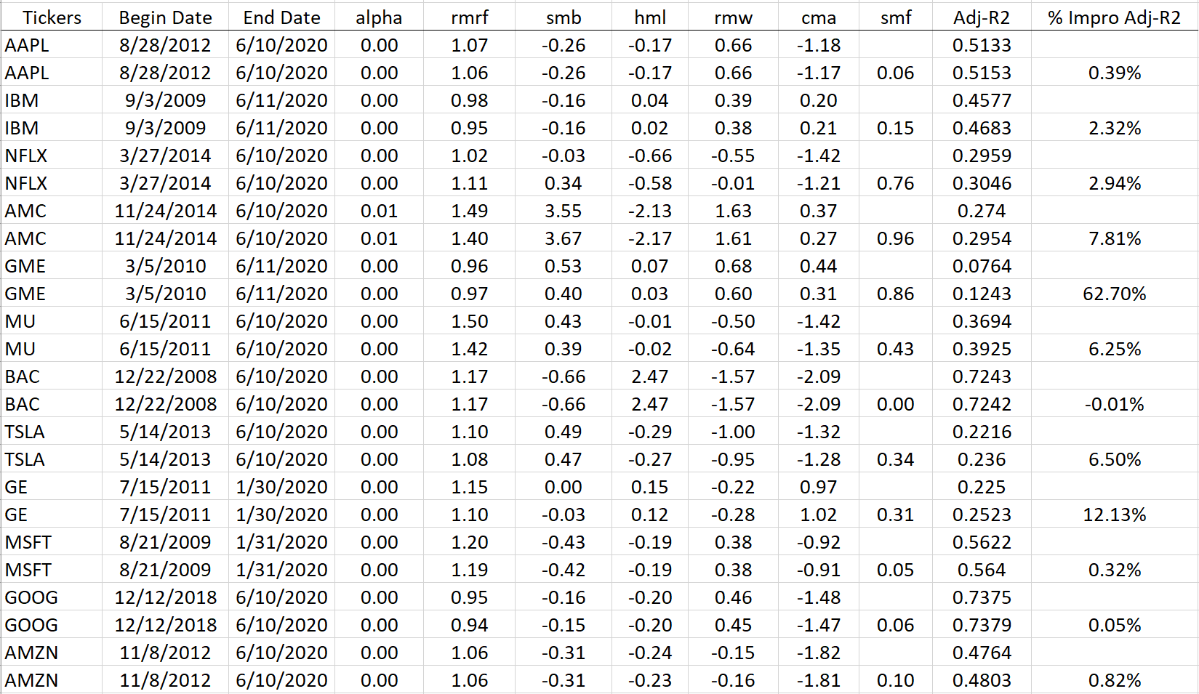
Coefficients

Slide 15
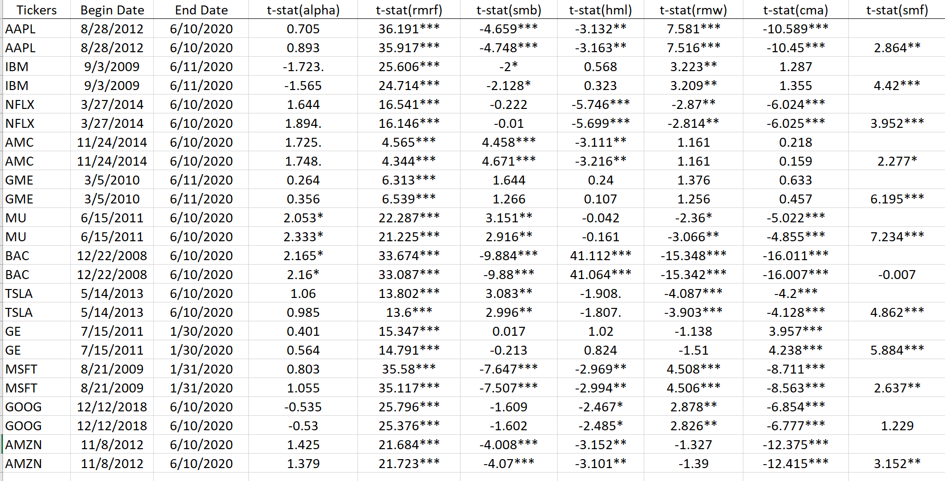
T-statistics

Slide 16
NLP Sentimental Model Comparison (LSTM vs FINBERT)
Fit Fama-French model without social media factor as the six factor: R2 score is 0.299
Fit Fama-French model with social media factor from LSTM: R2 score is still 0.299
Fit Fama-French model with social media factor from FinBERT: R2 score is 0.309
We prefer FinBERT rather than LSTM as it improves R2 score from traditional Fama-French model

Slide 17
Part III. Clustering Insights Extraction

Slide 18
Insights
In stock markets, there is the term 'Buy the Rumor, Sell the News'
If our Sentiment Score is high, then possibly, the news is already reflected in the stock price?
Are we buying at a high price and selling at a low price?
We used the clustering method to identify any abnormal return found on the return distribution to test this.

Slide 19
Clustering Models
K-Means
•Minimize a measure of dispersion within the clusters.
•Divide the sample into predetermined number k of nonoverlapping clusters so that clusters are as homogenous as possible with respect to the measurement used.
•I.E. Sum of distances from cluster centroid.
Optimization problem can be solved with integer programming

Slide 20
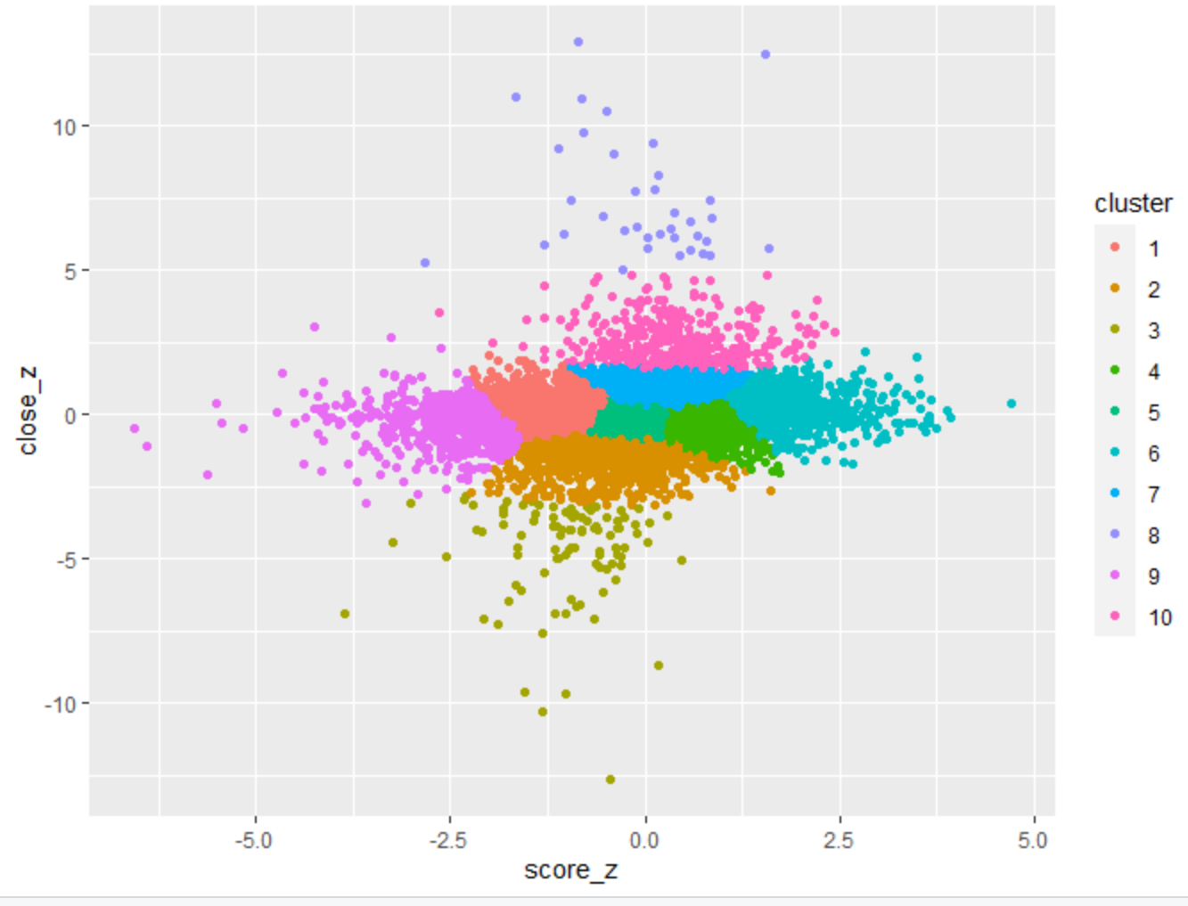
Result
North East: more clustering found with the positive returns and positive sentiments.
South West: more clustering found with the negative returns and negative sentiments.
The abnormal returns found on the center not on the tail.

Slide 21
Part IV. Excess return Predictions with Supervised learning Models

Slide 22
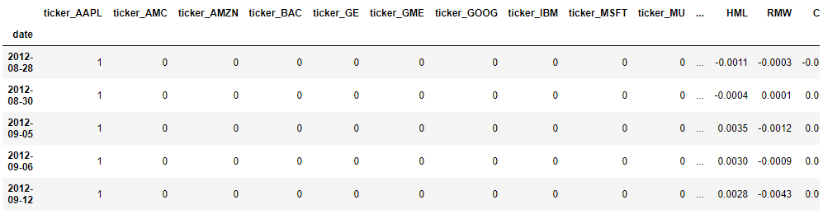
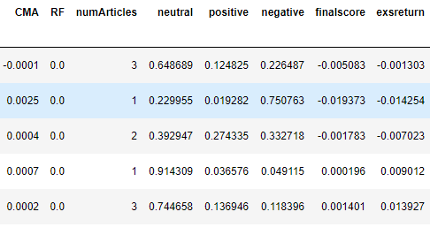
Data aggregation
The dataset is a combination of Fama-French and sentiment scores data frame based on FinBERT
Target variable is excess return, which equals to daily return minus risk free rate
Features are Fama-French factors, sentiment scores and converted dummy variables (ticker)
The best model should have the highest R2 score while no overfitting or underfitting issue
A snippet of combined dataset

Slide 23
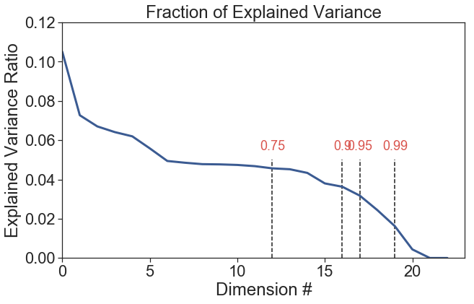
Dimension Reduction
Apply PCA technique to reduce dimension from 23 to 18, which explains 95% of variance
Apply standard scaler to transform training and test dataset into the same scale

Slide 24
Regression model descriptions
10 regression models are fitted: Linear regression, Support vector regression (linear), Support vector regression (rbf), Support vector regression (poly), Decision tree regression, Random forest regression, Gradient boosting regression, Ada boost regression, Voting regression and Bagging regression
Decision tree, Support vector regression (linear), Support vector regression (rbf), Support vector regression (poly) do not performance better as their R2 score are low (some are negative)
The base estimator for Ada boost and Bagging regression is Gradient boosting because of R2 score
The voting candidates for Voting regression are Linear regression, Random forest, Ada boost and Gradient boosting

Slide 25
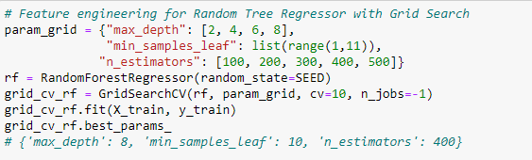
Feature engineering
Grid search method is applied for those models with feature engineering option
For example, for Random tree regression we apply grid search around max_depth, min_samples_leaf and n_estimators
Interestingly, grid search does not choose n_estimators of 500 as the best parameter
Note for max_depth, the higher the max_depth, the higher the R2 score. But the risk of overfitting also increases

Slide 26
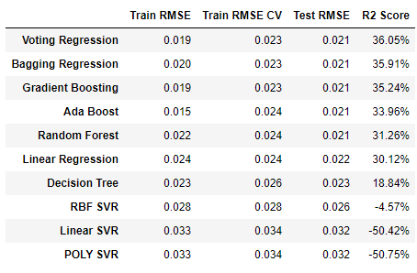
Model performance evaluation
Our evaluation standard is still based on R2 score. The higher the score, the better the model fits.
But we also want to avoid overfitting or underfitting problem. That is, Train RMSE, Train RMSE CV and Test RMSE should be close.
Given that, we are in favor of Bagging Regression. As it’s R2 score is just 0.14% lower than Voting Regression but the three errors are closer than Voting Regression.

Slide 27
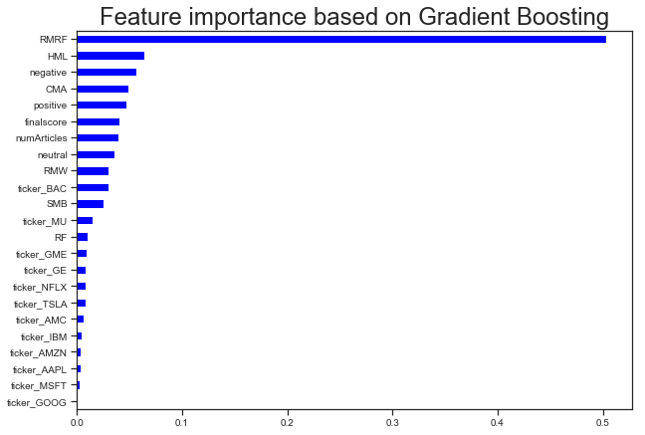
Feature importance
Determine feature importance based on Gradient Boosting model
All Fama-French factors explain 67% of feature importance
All Sentiment scores explain 18% of feature importance

Slide 28
Summary of Result/Further Actions/Recommendations
Insights Summary:
Find significant evidence that the characteristics of securities derived from social media information have significant power in explaining the time-series of daily returns across the sample of 12 stocks. The Social Media Factor, the “sixth” factor, is distinct from the traditional five factors authored by Fama and French (1992, 1993, and 1994).
Further Actions:
Based on sample result above, we could examine a broader sample of stocks to test more robustness for the model and also extend the analysis by different sector.
We can include longer term time series data since fama-french model is supposed to be in a long term indicators models
We can include more sources of news sentiments, sentiments from social media/platform such as Twitter, Reddits, Bloomberg

Slide 29
Summary of Result/Further Actions/Recommendations
Insights Summary:
Find enticing regression models that can predict stock excess returns better than linear regression model
Result/Further Actions:
For models with parameter max_depth, within a certain range the higher the max_depth, the higher the R2 score. But the risk of overfitting also increases. Another interesting finding is n_estimators. It is not always true that the larger n_estimators, the higher R2 score.
The Gradient boosting model has better performance than Random forest. It builds the model in a stage-wise fashion like other boosting methods do, and it generalizes them by allowing optimization of an arbitrary differentiable loss function. We can do more feature engineering/parameter tuning on this model.
As we can tell, the best fitted model has R2 score 36%, which indicates there is still a room for improvement. We can either include more meaningful features, or adopt more sophisticated ML models (Neural Network Autoregression) to boost prediction power.
Notes:
According to efficient market hypothesis, return cannot be predicted using past information so traditional time series model doesn’t work.
Also, a return series after transformation is usually a white noise, which is serially uncorrelated and unpredictable.

Slide 30
References
https://breakingdownfinance.com/finance-topics/performance-measurement/fama-french-5-factor-model/
https://blog.quantinsti.com/fama-french-five-factor-asset-pricing-model/
https://wandb.ai/authors/seo/reports/Getting-Started-with-Numerai-Signals-Sentiment-Analysis--Vmlldzo0OTgyMDI
https://colah.github.io/posts/2015-08-Understanding-LSTMs/

Slide 31
Thank you

